Slide 1
How to increase visibility in the market for fiction authors by using marketing strategies in social media platforms
Presenter: Hao Chen

Slide 2
Initial Results

Slide 3
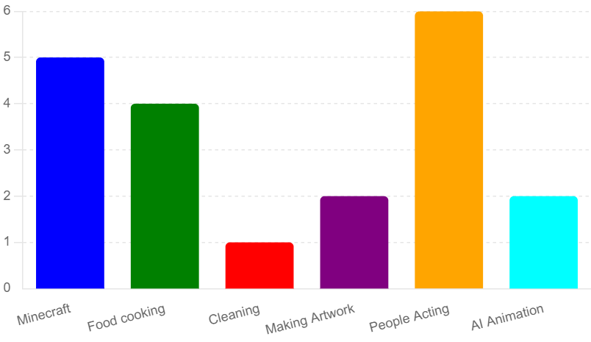
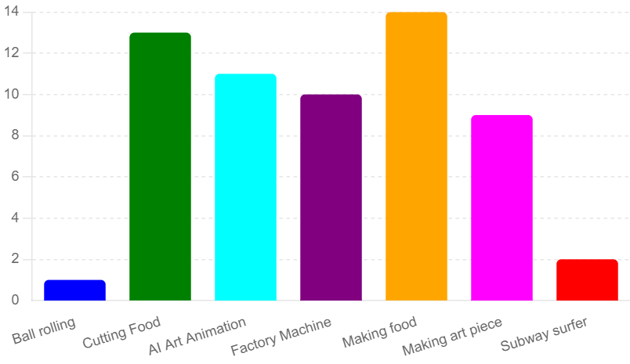
U.S. Tiktok #Story vs. Chinese Tiktok
U.S. Tiktok
Chinese Tiktok

Slide 4
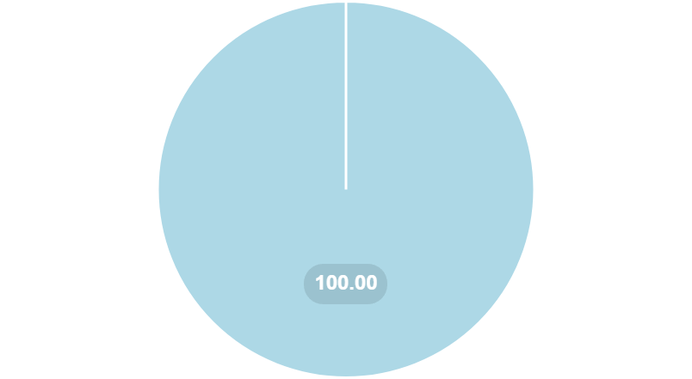
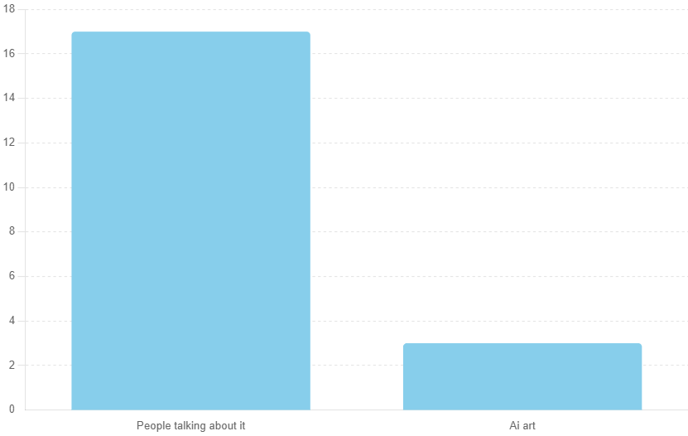
U.S. Tiktok #Booktalk Vs. Instagram
Tiktok
Instagram
people talking about it

Slide 5
Limitations

Slide 6
Limitations
Result come from limited platforms
Survey limited to NY State College Student

Slide 7
Limitations
30% of Instagram users are in age of 18-24 (Statista.com)
36.2% of U.S. Tiktok users are in the age of 18-24(Oberlo.com)

